Slide 1

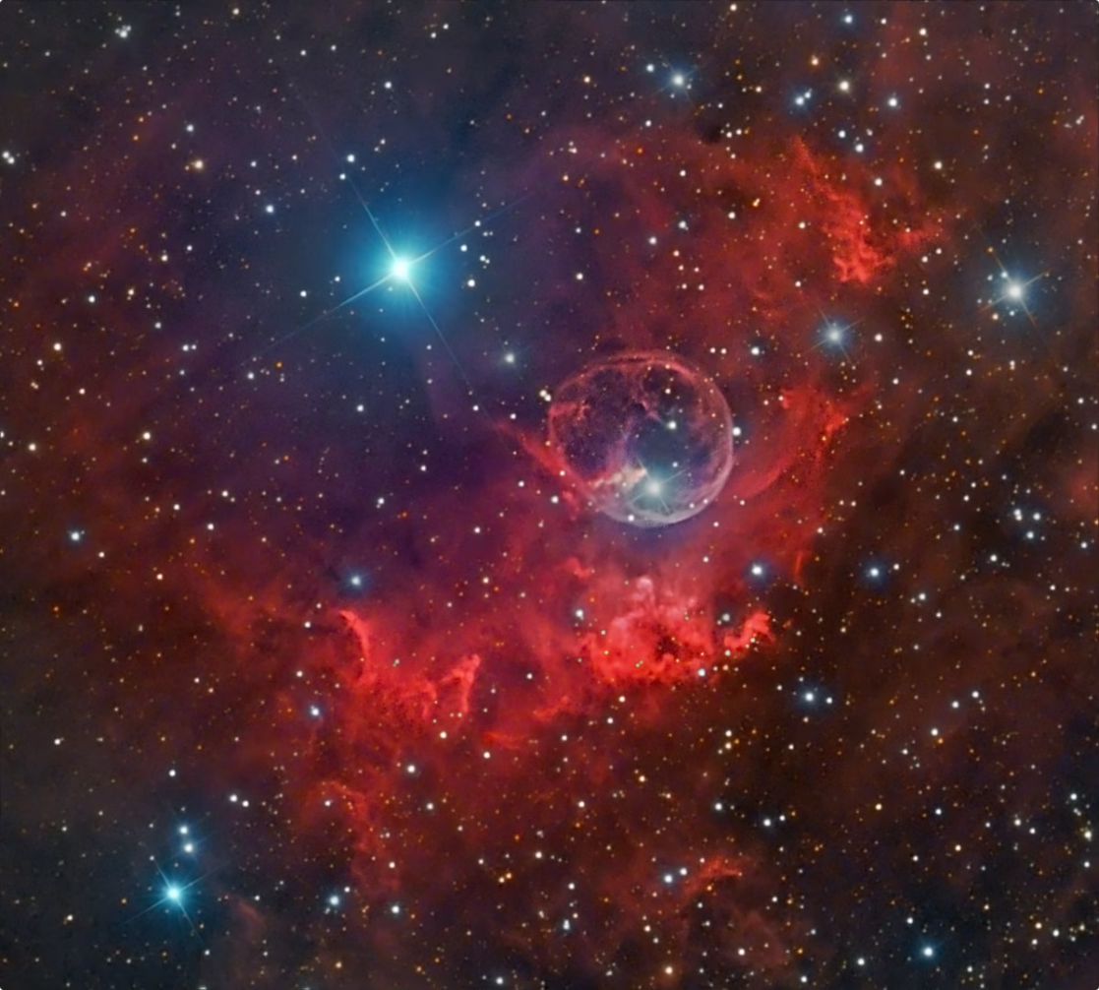
Quantum Computing: The Future of Computing
Quantum computing represents a paradigm shift in computing, harnessing the principles of quantum mechanics to solve problems that are intractable for classical computers. This emerging technology has the potential to revolutionize fields like medicine, materials science, artificial intelligence, and climate modeling.

Slide 2
Introduction to Quantum Mechanics
At the heart of quantum computing lies quantum mechanics, a branch of physics that describes the behavior of matter and energy at the atomic and subatomic level. Key concepts include superposition, where a quantum bit (qubit) can exist in multiple states simultaneously, and entanglement, where qubits become correlated even when separated by vast distances. These principles enable quantum computers to perform calculations in a fundamentally different way from classical computers.
1
Superposition
2
Entanglement
A qubit can exist in a combination of states (0 and 1) simultaneously, unlike classical bits which are restricted to a single state at a time.
Two or more qubits can become correlated, even when separated by large distances, allowing them to interact and share information in a unique way.

Slide 3

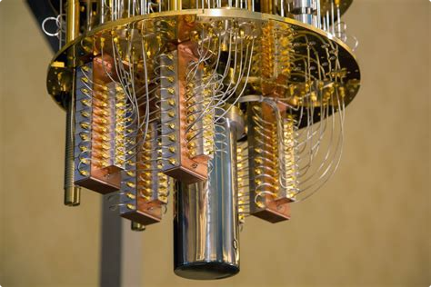


The Qubit: The Fundamental Unit of Quantum Computing
The qubit is the basic unit of information in quantum computing, analogous to the bit in classical computing. Unlike a bit, which can only represent 0 or 1, a qubit can represent a superposition of both states simultaneously. This capability allows quantum computers to process information exponentially faster than classical computers for certain types of problems.
Quantum Properties
Quantum Circuits
Qubits utilize quantum properties such as superposition and entanglement to perform computations in a fundamentally different way.
Quantum algorithms are implemented using complex quantum circuits that manipulate qubits through a series of quantum gates.

Slide 4
Climate Modeling: Understanding the Earth's Climate System
Climate modeling is a scientific discipline that uses mathematical models to simulate the Earth's climate system and predict future climate changes. These models incorporate complex physical processes such as atmospheric circulation, ocean currents, and radiative energy transfer. Climate modeling is crucial for understanding the past, present, and future of the Earth's climate, including the impact of human activities on the planet.
Data Collection
Climate models rely on vast amounts of data collected from satellites, weather stations, and other sources. This data provides information on various atmospheric and oceanic parameters like temperature, humidity, wind speed, and precipitation.
Model Simulation
Climate models are run on supercomputers to simulate the Earth's climate over different time scales, allowing scientists to study past climate trends and project future scenarios.
1
2
3
4
Model Development
Analysis and Interpretation
Scientists use mathematical equations to represent the physical processes that govern the climate system, such as the flow of energy, water, and momentum. These equations are incorporated into computer programs that can simulate the climate.
Scientists analyze the results of climate model simulations to understand the dynamics of the climate system, assess the impacts of climate change, and inform policy decisions.

Slide 5
The Role of Supercomputers in Climate Modeling
Climate models require immense computational power to solve complex equations and simulate the Earth's climate over long time scales. Supercomputers, with their massive processing capabilities, play a crucial role in climate modeling, enabling scientists to generate realistic and detailed simulations of the Earth's climate system.
Parallel Processing
High-Resolution Simulations
Long-Term Projections
Supercomputers utilize parallel processing, where thousands of processors work simultaneously on different parts of the calculation. This allows them to handle the massive amounts of data and complex equations involved in climate modeling.
Supercomputers enable scientists to run climate models for extended periods, allowing them to project future climate scenarios decades or even centuries ahead.
Supercomputers allow scientists to run climate models at higher resolutions, capturing smaller-scale processes and features that are important for understanding regional climate variations.

Slide 6


Modeling the Global Atmosphere and Oceans
Climate models are designed to represent the complex interactions between the atmosphere and oceans. They simulate the global circulation patterns, the exchange of heat and moisture, and the formation of clouds and precipitation. Understanding these interactions is essential for accurately predicting climate change and its impacts.
Atmosphere
Oceans
Air pressure, temperature, humidity
Sea surface temperature, salinity, currents
Wind patterns, cloud formation
Heat transport, ocean circulation
Greenhouse gas concentrations
Carbon dioxide uptake and storage

Slide 7




Simulating Climate Change and Environmental Impacts
Climate models are used to simulate the effects of climate change on various environmental factors, including temperature, precipitation, sea level rise, and extreme weather events. By incorporating different scenarios of greenhouse gas emissions and other human activities, scientists can assess the potential impacts of climate change on ecosystems, agriculture, water resources, and human health.
Greenhouse Gas Emissions
Climate models simulate the effects of increasing greenhouse gas concentrations in the atmosphere, such as carbon dioxide, methane, and nitrous oxide.
Temperature Changes
The models project increases in global average temperature, with greater warming in certain regions of the world.
Sea Level Rise
Climate models simulate the melting of glaciers and ice sheets, contributing to rising sea levels, which can inundate coastal areas and displace populations.
Extreme Weather Events
Climate models project increases in the frequency and intensity of extreme weather events such as hurricanes, droughts, and floods, which can cause significant damage and disruption.

Slide 8
Predicting Extreme Weather Events
Climate models can be used to predict the occurrence and intensity of extreme weather events, such as hurricanes, floods, and droughts. While these models are not perfect, they provide valuable insights into the likelihood and potential impacts of extreme weather, enabling better preparedness and mitigation strategies.
Hurricane Prediction
Flood Forecasting
Drought Monitoring
Climate models can track the formation and movement of hurricanes, helping forecasters predict their paths and potential impacts on coastal areas.
Climate models can simulate the effects of heavy rainfall and rising sea levels on river systems, providing valuable information for flood mitigation and emergency response.
Climate models can help identify areas at risk of drought by simulating the effects of low precipitation and high temperatures on water resources.

Slide 9


Improving Climate Projections through Quantum Computing
Quantum computing has the potential to revolutionize climate modeling by enabling more accurate and efficient simulations. Quantum algorithms can tackle computationally intensive tasks, such as simulating the interactions of molecules and atoms, which are essential for understanding climate processes at a fundamental level.
Enhanced Accuracy
Faster Simulations
Quantum computers can simulate complex molecular processes that are beyond the reach of classical computers, leading to more accurate climate models.
Quantum computers can significantly speed up climate simulations, allowing scientists to explore a wider range of scenarios and generate more comprehensive predictions.

Slide 10

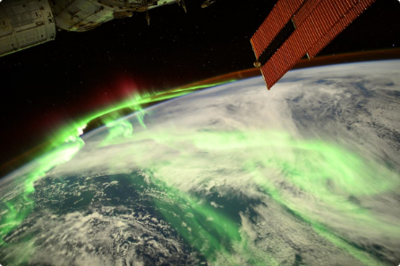
Conclusion: The Convergence of Quantum Computing and Climate Science
The convergence of quantum computing and climate science holds immense promise for advancing our understanding of the Earth's climate system and addressing the challenges of climate change. By harnessing the power of quantum computing, scientists can develop more accurate, efficient, and insightful climate models that inform policy decisions and guide our path towards a sustainable future.

Slide 11
THANK YOU
22071A6725-K.JITENDRA

